Slide 1
LOGICRON Is quantum computIng ready for aws servIces?
Ege Doğan Dursun
Muneeb Alnuaimi
Gamze Karan

Slide 2
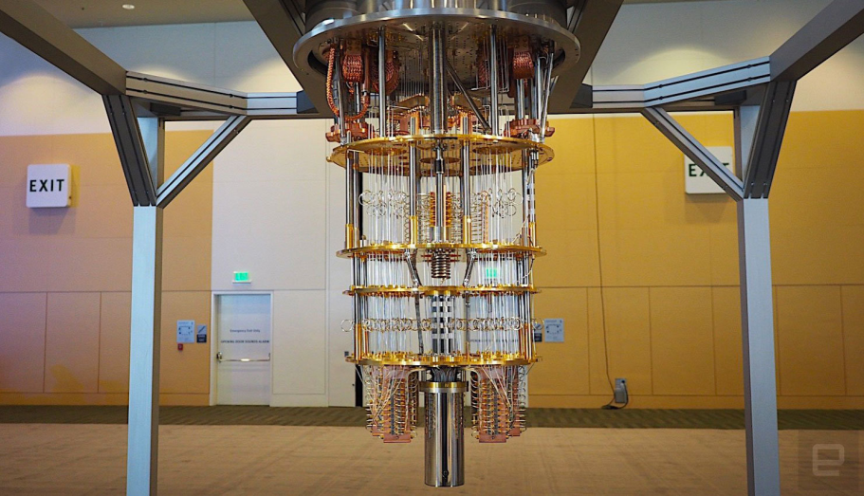
Index
What is Quantum Computing? – pg. 5-9
What is the core differences between Quantum Quadri-binary Computing and Conventinal Binary Computing? – pg. 10-13
How Is Quantum Computing More Powerful? – pg. 14-19
The Future of Quantum Computing – pg. 20-24
What is a Quantum Annealer? – pg.25
How to Cook Powerful Commercial Application Recipes by Combining AWS Services and Quantum Cloud Applications? – pg. 26-27

Slide 3
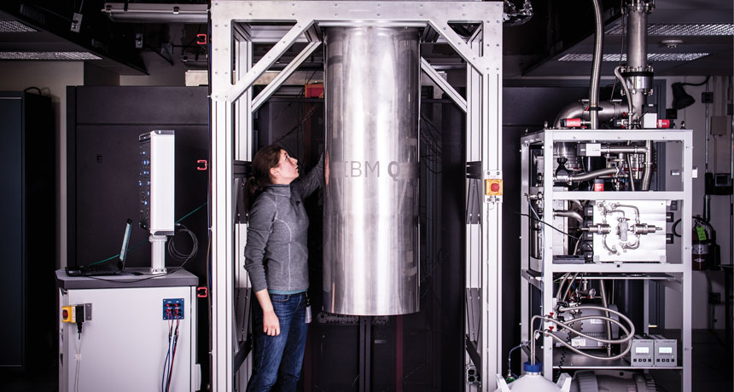
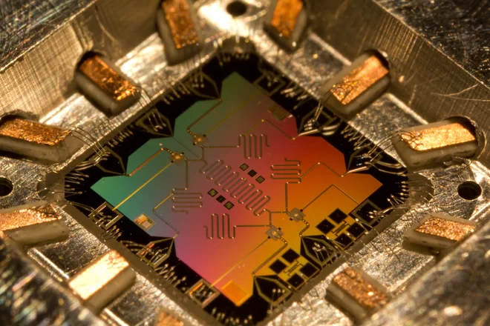
Index
Meet Quantum-Powered Trade & Logistics Application: LOGICRON – pg. 28-29
A Short Recap of Travelling Salesman Problem – pg. 30-32
How Quantum Annealer destroy NP-Hard Problem Classes? – pg. 33

Slide 4
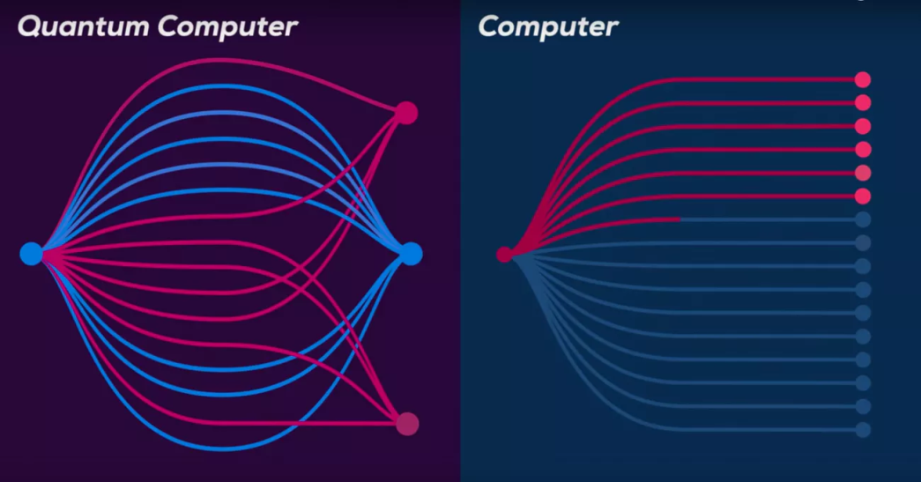
Index
Vision – pg. 34
Scope and Boundaries of LOGICRON – pg. 35
Use Cases – pg. 36
Income Model – pg. 37
Application Architecture – pg. 38
Technologies and Frameworks – pg. 39
Development Time Schedule – pg. 40
References – pg. 41
Code and Commentary – pg. 42-64
Challenges During Development – pg. 65-66

Slide 5
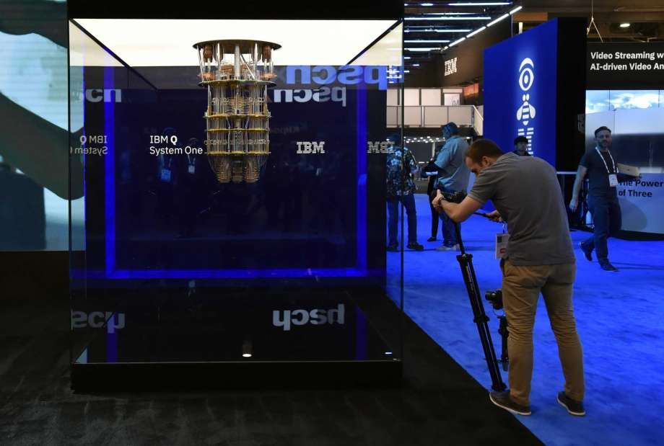
What Is quantum ComputIng?
Quantum Computing is not a new type of computational approach, but is the discovery of the true nature of computation.
A Quantum Computer is the Computational Device that operates not under the rules of Traditional Physics, but Quantum Physics.
Quantum Laws of Nature is nearly completely different than Traditional Physics Rules and have their own mechanisms that works for sub-atomic particles; which knit the fabric of the whole universe together.

Slide 6
Quantum Computers operate by using 3 main rules of Quantum Laws of Physics:
Superposition
Entanglement
Measurement

Slide 7
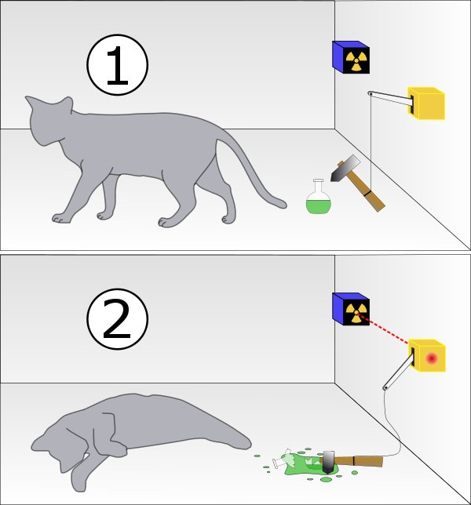
Superposition: Quantum Particles such as electrons and photons possess a popular Quantum Phenomenon called Schrodinger Uncertainty.
«As a certain rule of universe, an electron’s location and speed can not be known at the same time.»
Famous Example: Schrodinger’s Cat:
Suppose that you have a black box that you can not see, hear, smell, taste or touch through what is inside of it.
There is a cat inside the box, and there is also a bottle filled with cyanide.
There is a mechanism inside the box, that will break the glass that is filled with cyanide with an absolute 50% probability, therefore killing the cat by poisoning.
With 50% probability, the mechanism will not break the glass, therefore the cat will stay alive.
Schrodinger Uncertainty tells us, as long as you can’t observe inside of the box, the cat is both alive and dead at the same time.

Slide 8
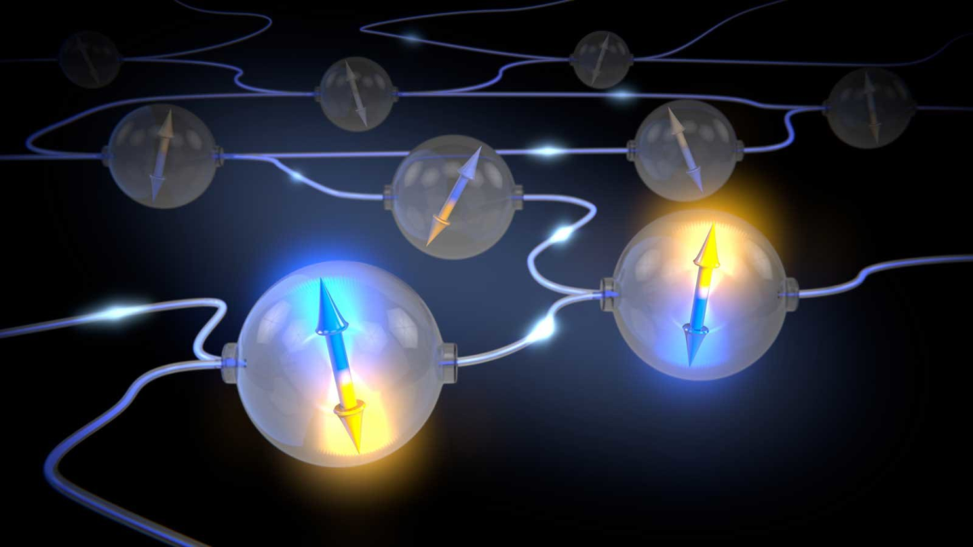
Same is valid for sub-atomic particles such as electrons and photons. Their spin value is uncertain, «until» the time we measure it.
Entanglement: Quantum particles are continuously interacting with each other by means of a Quantum phenomenon called Entanglement. This basically means that an electron may be entangled/bounded to another electron in the universe and changing one of them will instantly result in the change of the other. This phenomenon can be called as «teleportation».

Slide 9
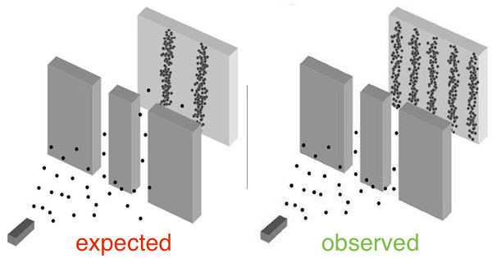
Measurement: We discussed the strange and seemingly supernatural properties of Quantum Superposition. We know that a quantum particle can have multiple conditions at the same time, so it carries an uncertainty. The key point here is; the uncertainty of the particle withstands if and only if the particle stay unmeasured. As the time we measure the condition of the particle, it transforms into a certain value and therefore the uncertainty is diminished.
So we can say that the cat inside the box is both alive and dead at the same time before we measure (open the box) , but by the time we open the box, the system loses it’s uncertainty and we see that the the cat is either alive or dead.

Slide 10
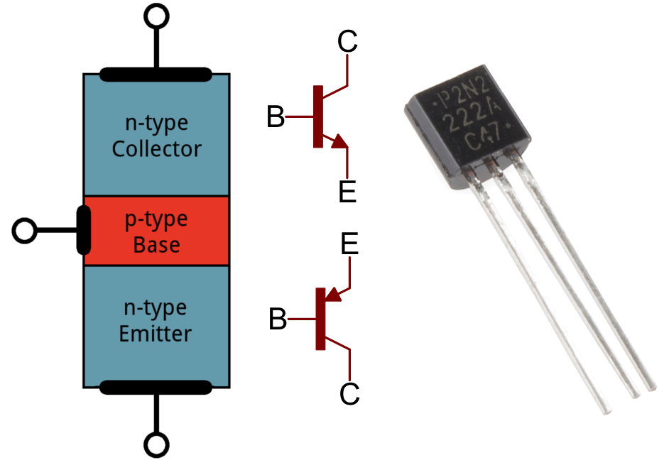
What is the core differences between Quantum Quadri-binary Computing and Conventinal Binary Computing?
Conventional binary computers use transistors as their key components to store information.
Transistors provide us to transform electrical flow into interpretable logical data that is encoded with values 1 and 0.
A conventional binary computer’s data domain only consists of these binary values. So it doesn’t matter if the data is primitive or complex; it is made of the combination of 1’s and 0’s.

Slide 11
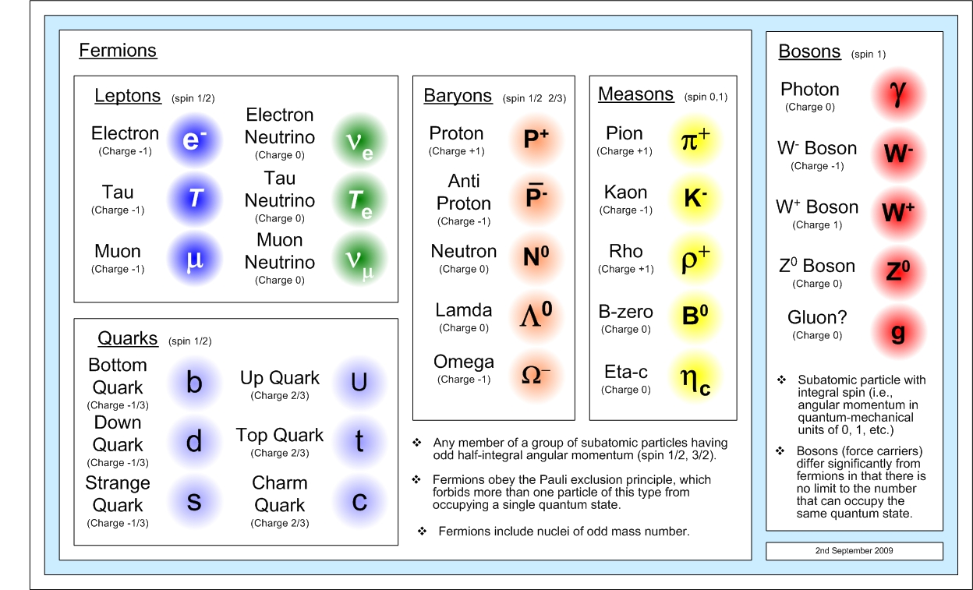
On the other hand, a Quantum Computer’s key components for doing computation are not transistors, but quantic particles such as electrons and photons.
As we discussed before, electrons possess quantum phenomenons called superposition, entanglement and measurement. This means that electrons are not only capable of storing information in the form of 0’s and 1’s but also both 1 and 0 at the same time. They can also have a value in between 0 and 1, until the time we measure it.
Also, quantum computers work under the property of Quantum Entanglement, that means we can teleport information from one point of the universe to another part of the universe in 0 seconds just by entangling electrons.

Slide 12
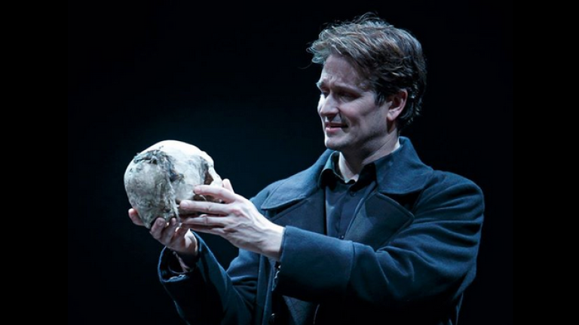
If Shakespeare wrote Hamlet after Quantum Computers are invented:
Traditional Binary Hamlet:
«To be or not to be, that is the question.»
Quantum Quadri-binary Hamlet:
«To be or not to be, or to be and not to be at the same time, or some other thing between being and not being. That is the question, or that is not the question, or maybe it is and not the question at the same time, or maybe something in between them.
I am glad that I lived before Einstein.

Slide 13
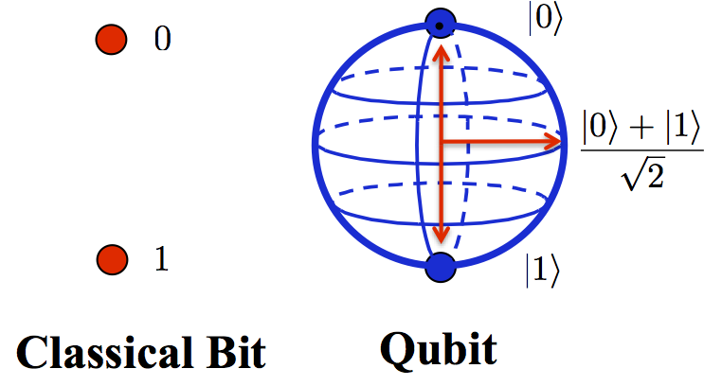
Modern Quantum Computers process information by using their Quantum Processing Units (QPU).
QPU’s operating principle depends on manipulating, entangling and measuring electrons or photons.
The value of a sub-atomic particle depends on it’s quantum spin.
The most simple piece of information in Quantum Computing is called Qubit.
If the spin of an electron is up; the value of the Qubit is 0. If the spin of an electron is down; the value of the Qubit is 1. If the spin is unmeasured, it can be either 1 or 0 or both at the same time as well as something in between 0 and 1.

Slide 14
How Is quantum computIng more powerful?
Quantum Computer’s efficiency depends on the way they process information. They are not finite devices as Turing Machines, but the exact opposite. They are completely limitless as they operate by using the Quantum Laws of Physics.

Slide 15
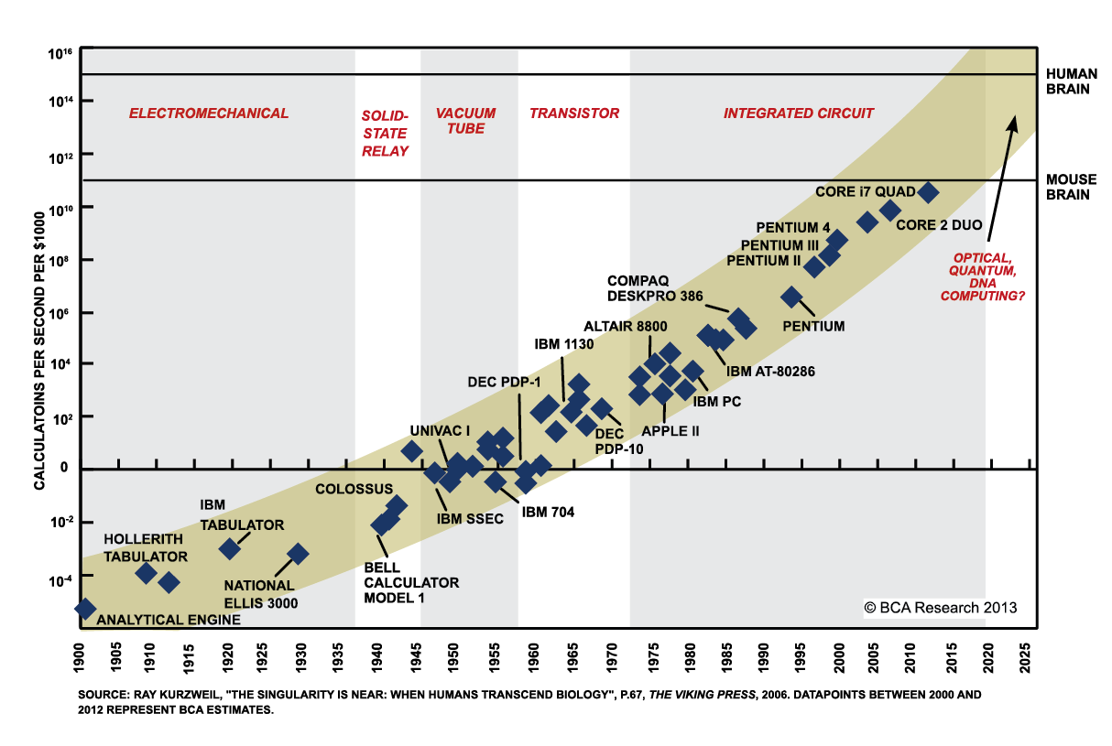
Moore’s Law tells us that the speed and capability of computers can be expected to double every two years, as a result of increases in the number of transistors a microchip can contain.
So the success rate of Moore’s law depends on how many transistors can be fitted in a certain amount of area.
The problem here is, a transistor is a mechanism designed to either stop or permit the electrical flow passing by itself.

Slide 16
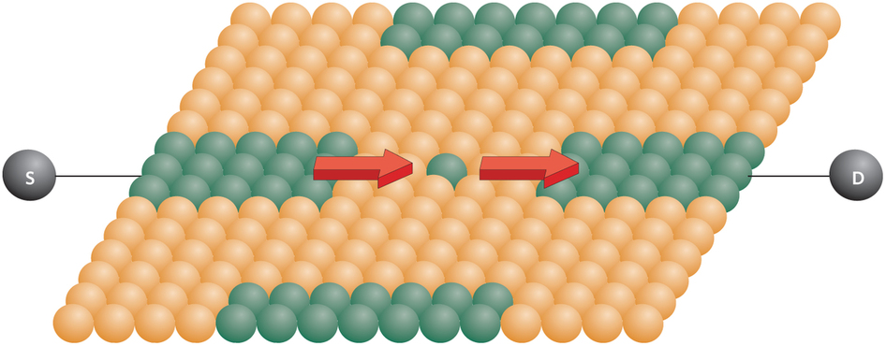
In order to stop the flow of the electric, we have to put some atoms on the way of the flow.
The minimum number of atoms that we can use in order to stop electrical flow is certain. It is «1». You can not stop electricity with something smaller than the size of 1 atom.
So there will be a point in some near future, that the transistors won’t be able to get smaller anymore.
Today, the smallest transtors consist of 4 atoms in length.
Therefore, Moore’s Law is doomed.

Slide 17
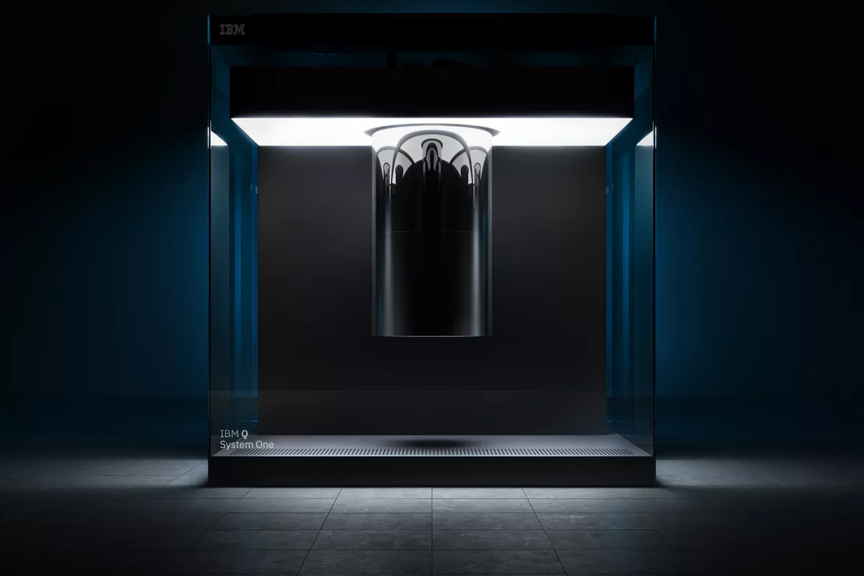
Quantum Computers, on the other hand stores information directly in Quantum Particles such as Electrons and Photons.
The size of sub-atomic particles are very very small, and there is no need to directly connect them to each other as we fix the transistors on computer chips.
This is because of the entanglement property. Quantum Particles are bonded to each other with invisible bounds.
As Quantum Computers directly operate by using the laws of the universe, simulating physical and biological events on quantum computers is billions of times easier than simulating them with a conventional computer.

Slide 18
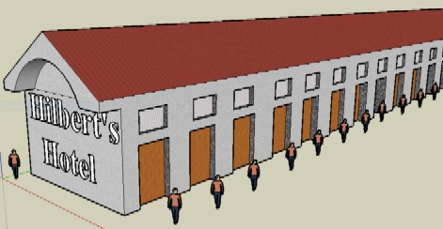
The Hotel Problem:
Suppose that you stayed at a hotel, and as you are leaving, you realized that you forgot your wallet inside the room.
Assume that the hotel management does not know in which room you have stayed. Think of an algorithm to find your wallet. How the hotel management would find your wallet?
The binary answer is simple; assign a hotel employee, start from room [0] and continue your search until room [499], if you find the wallet, return it to the customer.
In the best case, you found the wallet in the first room, in the worst case you found the wallet in the 500th room.
Not very efficient.

Slide 19

What would a Quantum Computer do in that situation?
The answer is very simple;
It would assign a hotel employee.
The employee would teleport into the «both» 500 rooms at the same time.
The wallet is instantly found.
Case solved, thanks to the superposition and entanglement properties of the electrons.

Slide 20
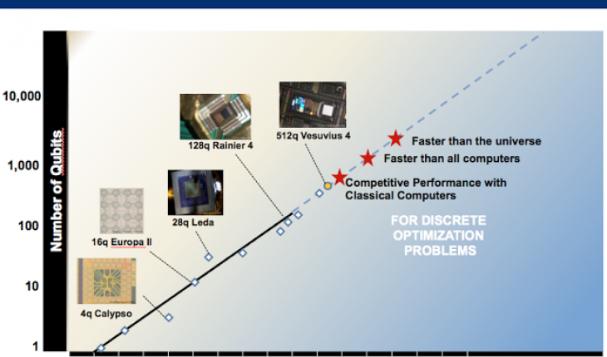
The future of quantum computIng
As transistors’ efficiency will inevitably reduce in the future, Quantum Computers will become more and more necessary in the near future.
Just as traditional computers have Moore’s Law, Quantum Computers has it’s own law: Rose’s Law.
Rose went on to suggest that the number of qubits in a scalable quantum computing architecture should double every year.

Slide 21
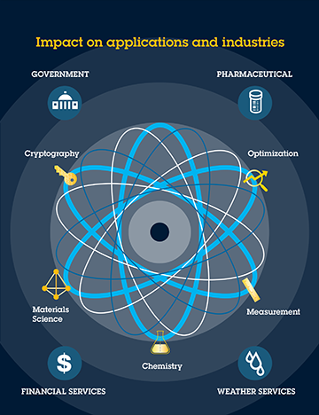
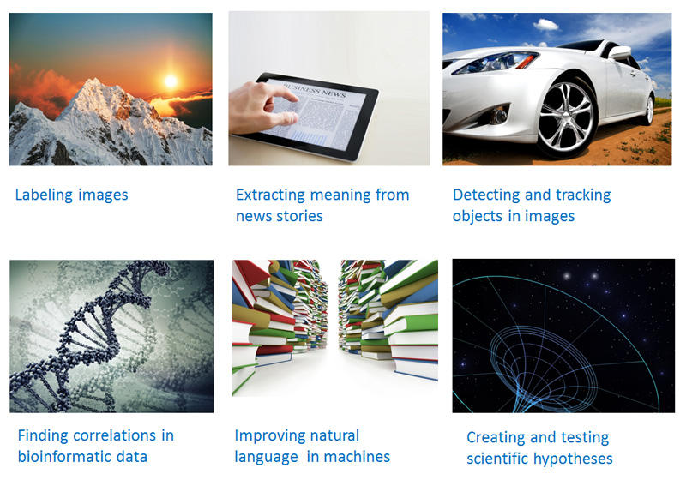
There are many areas that the Quantum Computers will be highly efficient.

Slide 22
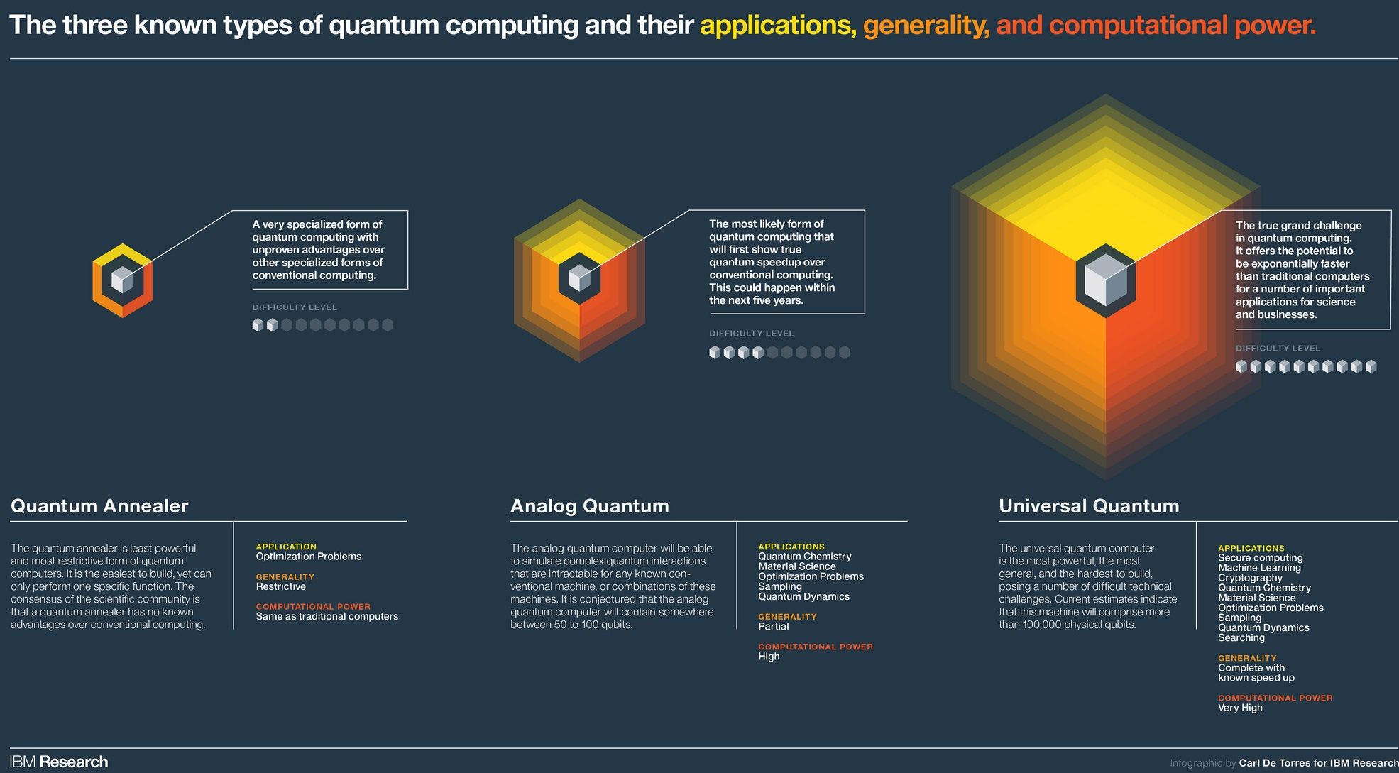
Even now, Quantum Computers are highly powerful.
As an example of their power, think of all the computations have ever been made by all of the computers all around the world since 1950; a quantum computer calculated them all in just 3 hours.
Future is even brighter.

Slide 23
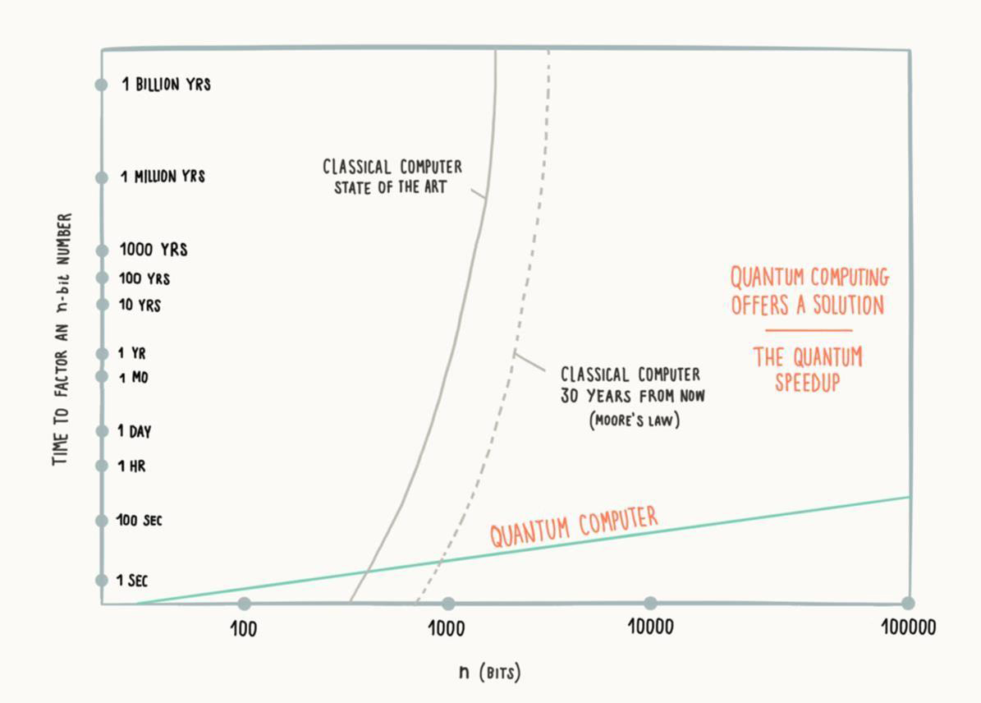

Slide 24
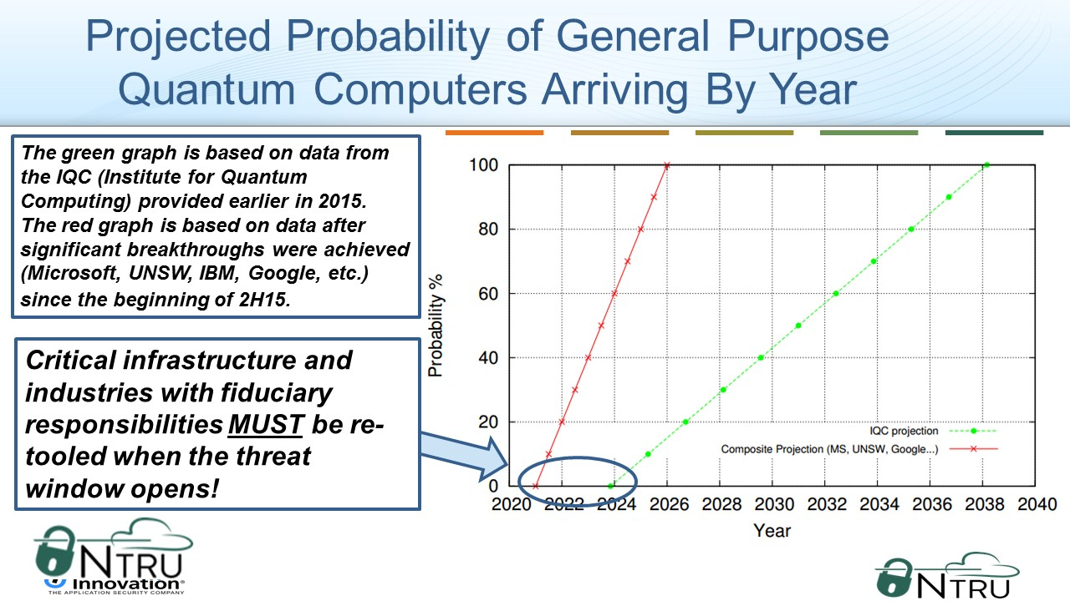

Slide 25
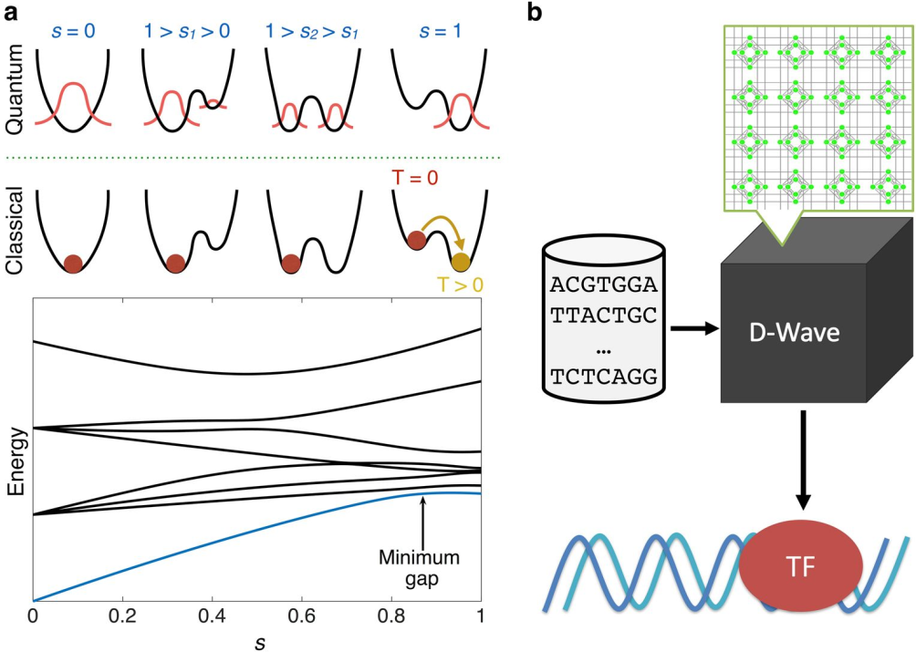
What Is a quantum annealer?
Quantum annealing (QA) is a metaheuristic for finding the global minimum of a given objective function over a given set of candidate solutions (candidate states), by a process using quantum fluctuations.

Slide 26
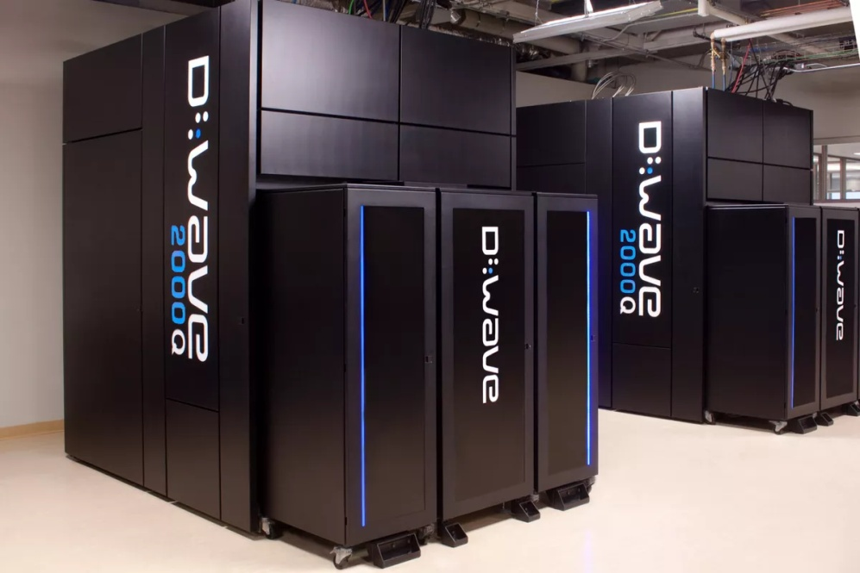
How to Cook Powerful Commercial Application Recipes by Combining AWS Services and Quantum Cloud Applications?
D-Wave is the first company that offers a commercially available Quantum Computer for sale.
D-Wave also shares cloud services called LEAP and Ocean SDK, that lets us directly use the Quantum Annealer for developing Quantum Applications.
For the developers, up to 1 minute of QPU usage is free. As Quantum Annealers are very fast, 1 minute is a really big time.

Slide 27
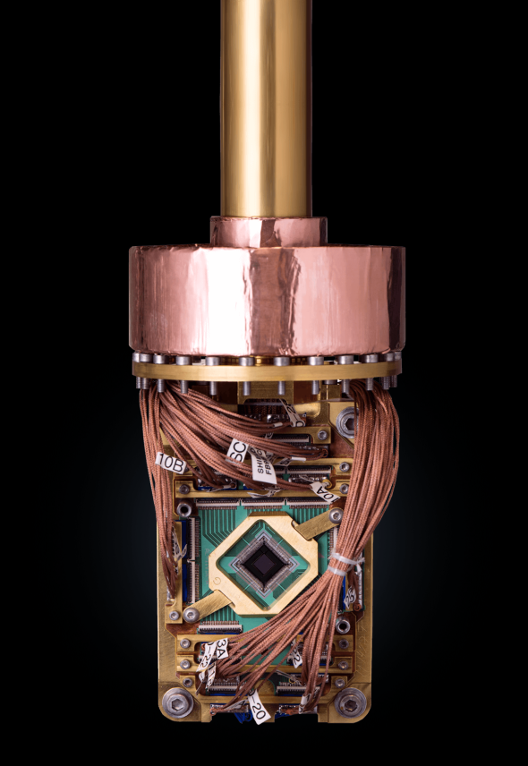


AWS, on the other hand lets us develop our own cloud computing solutions by providing the necessary services such as Database, Storage etc.
Why not combine both the Quantum Computing and AWS to create revolutionary applications?

Slide 28
Meet Quantum-Powered Trade & Logistics Application: LOGICRON
Our application combines the powerful Quantum Annealer cloud service with the Amazon Web Services to provide lightning fast distribution solutions for the logistics companies.

Slide 29
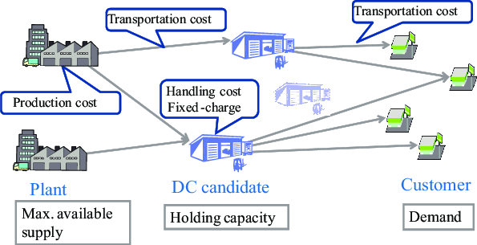
Each logistics company has it’s own distribution routes between multiple factors such as suppliers, factories, customers, warehouses etc.
Each route has their own predictable and unpredictable conditions such as the weather, road quality, traffic.
The carrier vehicle also has parameters such as gas consumption, energy of the driver, quality condition of the engine and tires etc.
Logistics companies try to create the best efficient distribution network by analysing all of these information.
Unfortunately, by using today’s binary computers, this is a task nearly impossible to accomplish. Here is why:

Slide 30
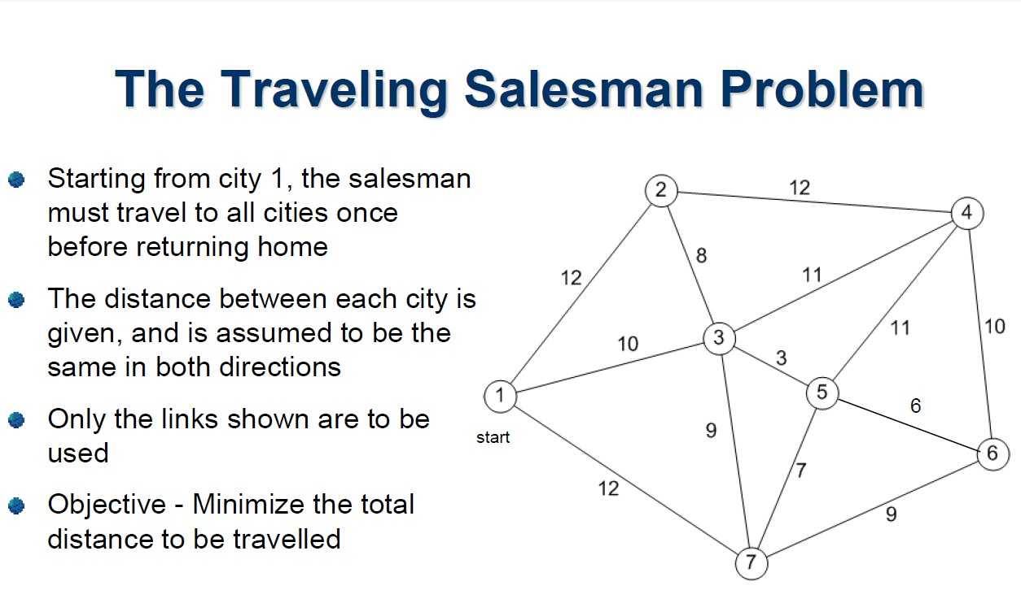
A Short Recap of Travelling Salesman Problem

Slide 31
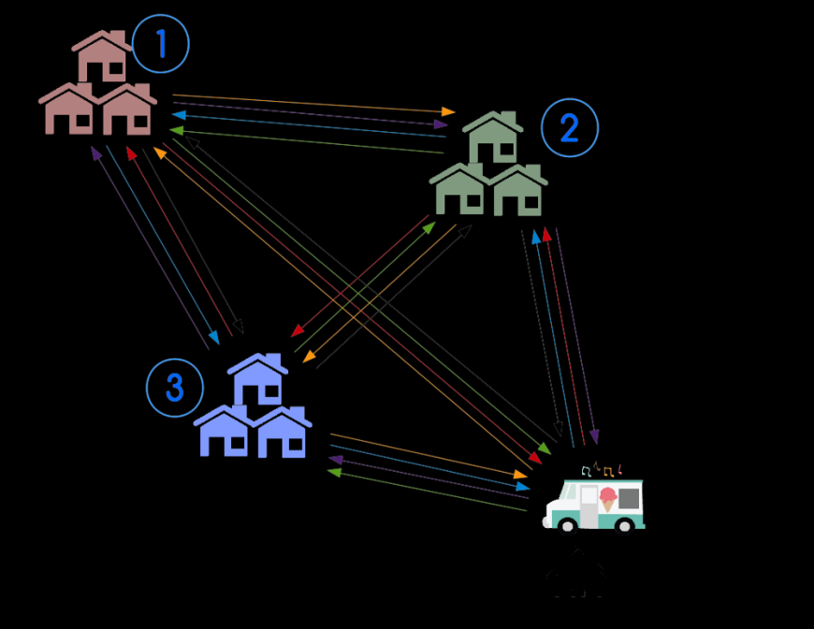
This problem’s complexity is approximately 7! because it has 7 nodes.
This problem may seem like pretty solvable to anyone who has a good friendship with mathematics and algorithm analysis.
However, think of a system that contains 70 nodes instead of 7 nodes. Now we have a solution complexity of 70!.
Next, think of a system with 700 nodes, or 7000, 70.000 and so on.
These kind of problems are classified as NP-Hard in Algorithm Analysis.
The reason they are hard to compute is, «there is basically no way to find the answer» , without computing all the ways.
At least, if we are not using a Quantum Annealer.

Slide 32
Our application offers a fast and efficient way to Logistics companies to create distribution networks.
We use AWS services (S3 Storage) to store the distribution knots of the companies.
Our Python script serves as a medium that will be used to combine the AWS with the Quantum Annealing Service.
The script will get the distribution knots from the AWS Storage and will send them serially to the Quantum Annealing Processor in order to find the most efficient possible route.

Slide 33
How Quantum Annealer destroy NP-Hard Problem Classes?
As we discussed before, Quantum Computers operate under the laws of Quantum Physics.
Let us remember the hotel example; we needed to check both of the rooms until we found our wallet. But the Quantum Computer would only need to teleport a pivot into all of the rooms to find our wallet in an instant.
This is exactly how Quantum Annealers destroy the np-hard problem classes. By using Superposition and Entanglement rules.

Slide 34

vIsIon
The vision of our application is to provide a B2B – SaaS solution for the Trade & Logistics companies who are in search of efficient distribution networks.
We provide added value by reducing the research costs spent on finding the most efficient distribution routes.
Our service is able to analyze large-scale NP-hard distribution knots efficiently by using revolutionary Quantum Annealer technology.

Slide 35

Scope and boundarIes
LOGICRON’s objective is to provide solutions to the distribution route problems of the Trade & Logistics companies.
LOGICRON does not limit the size of the distribution knot to be analyzed, but system boundary is limited to anneal only distribution knots that will be read from the AWS S3 Storage System.
Any function and use case that does not fulfill these aspects are not supported by LOGICRON.

Slide 36
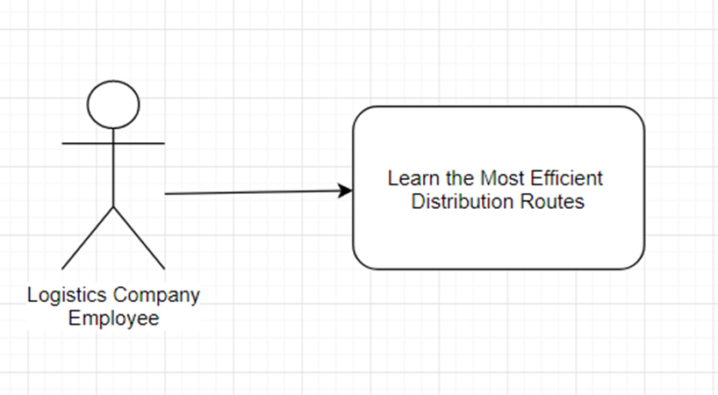
Use cases
Logistics Company Employee uses the LOGICRON-API by achieving an API-key provided by the LOGICRON.
The user sends the AWS S3 Storage permission information to the LOGICRON-API.
LOGICRON will get the distribution knots that will be analyzed from the AWS S3 Storage.
System will send the knots to the Quantum Processing Unit to be annealed.
System will return the results that are achieved from the QPU to the Logistics Company Employee.

Slide 37
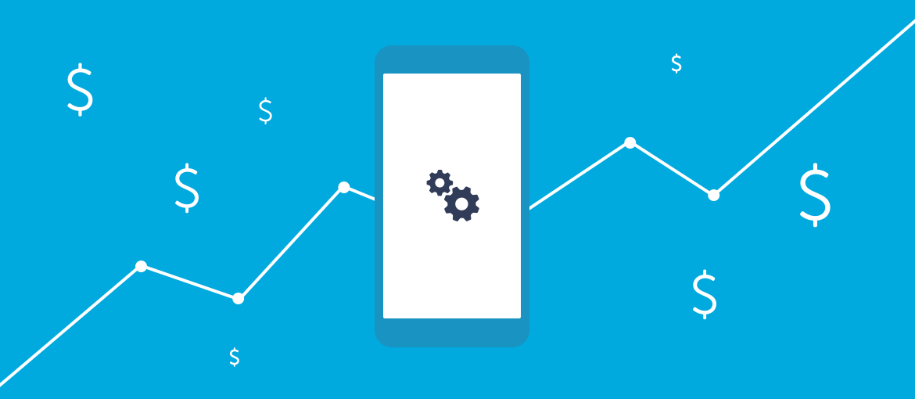
Income model
LOGICRON is a service based on the QPU usage.
Pricing is $0.75 per QPU seconds for operations under 1 minutes.
Pricing is $0.73 per QPU seconds for operations between 1 and 5 minutes.
Pricing is $0.70 per QPU seconds for operations more than 5 minutes.
For customers who need the QPU service for more than 30 minutes; special pricing offers apply.

Slide 38
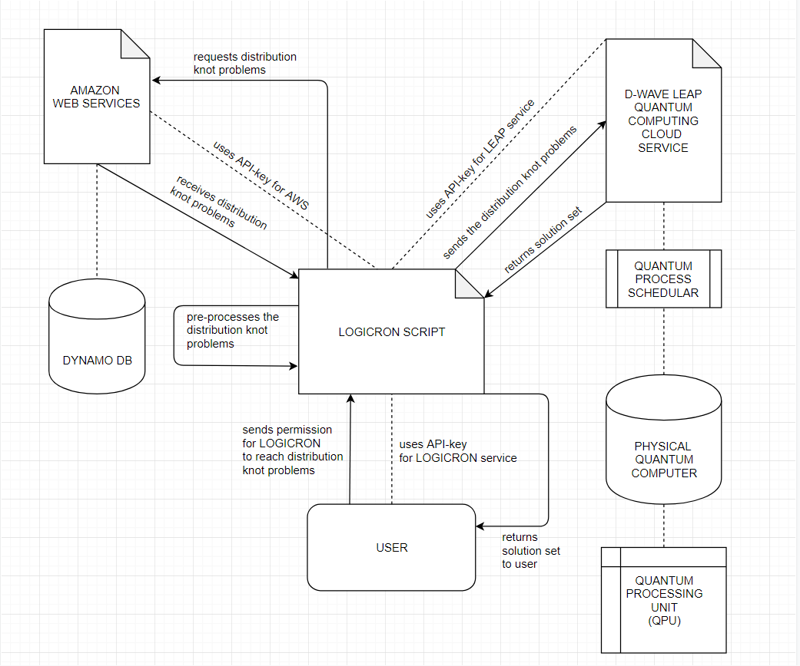
ApplIcatIon archItecture
Metin eklemek için tıklayın
S3 Storage
Buckets

Slide 39



TechnologIes and frameworks
Programming Language: Python
Script Extension: .ipynb
SDK: OCEAN, Leap, Matplotlib, NetworkX,
IDE: Python Notebook, Spyder, IntelliJ
Technologies: Amazon Web Services, S3 Storage, Quantum Annealing by D-Wave Leap & Ocean SDK

Slide 40

Project development TIme schedule
Week 1: Integrating the D-Wave Leap API as a singleton module and validate it by testing with example distribution knot values.
Week 2: Integrating the Amazon Web Services – S3 Storage API as a singleton module and validate it by testing it with example read and write values.
Week 3: Designing and implementing the necessary object class that will be used to store distribution knot principles by applying the OOP principles.
Week 4: Designing and testing the S3 Storage by using object structure of the project.
Week 5: Designing and testing the D-Wave Leap by using the object structure for the project.
Week 6: Merging the modules and testing them as a whole system.

Slide 41
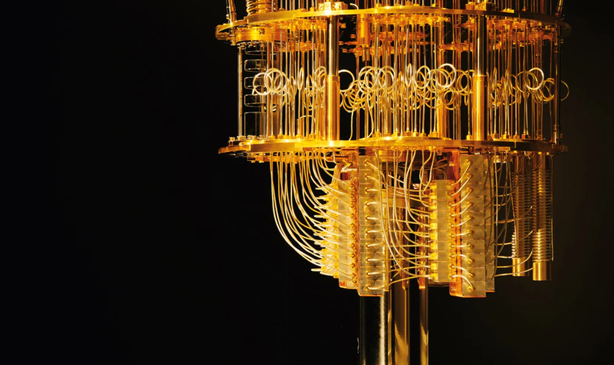
references
Quantum Computing for Everyone – Chris Bernhardt , MIT Press
Practical Quantum Computing for Developers – Vladimir Silva – Apress
Quantum Computation and Quantum Information – Michael A. Nielsen & Isaac I. Chuang – Cambridge
Quantum Machine Learning – Peter Wittek – Elsevier Insights

Slide 42
Code and commentary
Step 0: Importing the Necessary Libraries for Graph Generation
Introduction A: Comprehending the Struggle of Travelling Salesman Problem
Introduction B: Performance Comparison of CPU and QPU
Introduction C: Accomplishing the Impossible with Quantum Annealer
Step 1: Initializing the Conditions We Want to Determine for Generated Graph Problems
Step 2: Generating the Trial Graph Problems

Slide 43
Step 3: Storing the Generated Graphs in AWS S3 Storage Buckets
Step 4: Retrieving the Graphs from the S3 Buckets
Step 5: Solving The Graphs in Quantum Processing Unit (QPU) by D-Wave
Step 6: Storing the Graph Results in AWS S3 Buckets
Step 7: Retrieving the Graph Results from S3 Buckets
Step 8: Printing the Result Lists

Slide 44
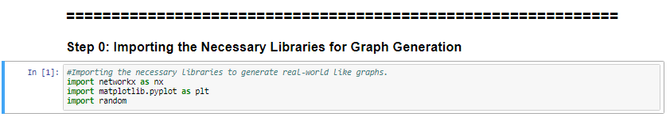

Slide 45
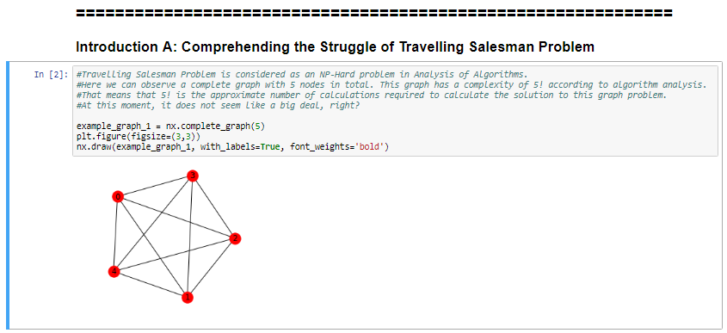

Slide 46
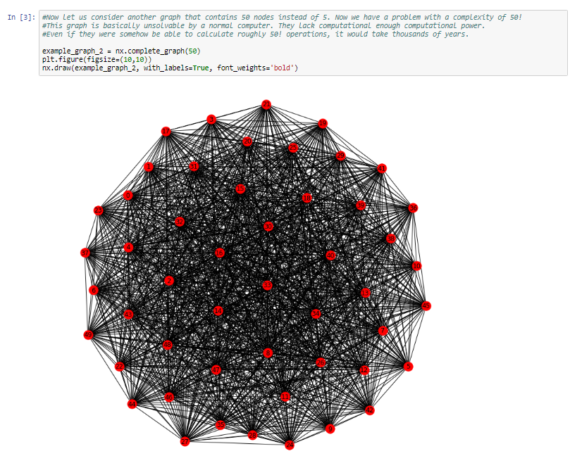

Slide 47
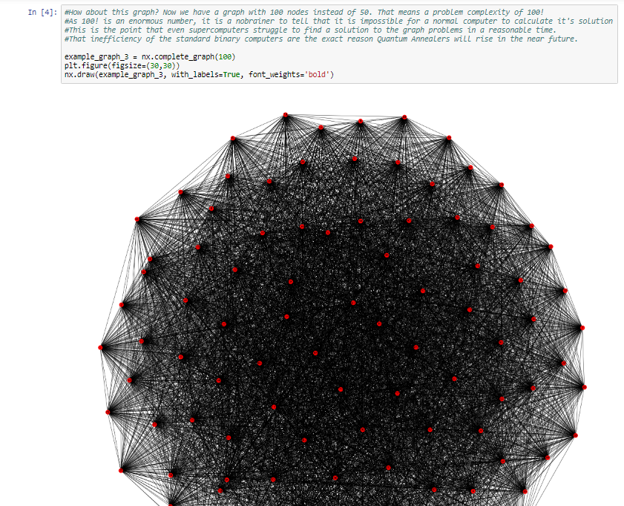

Slide 48
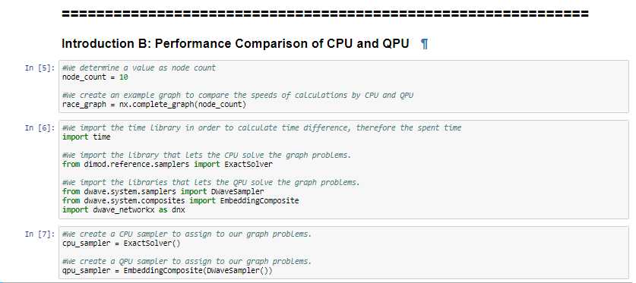

Slide 49
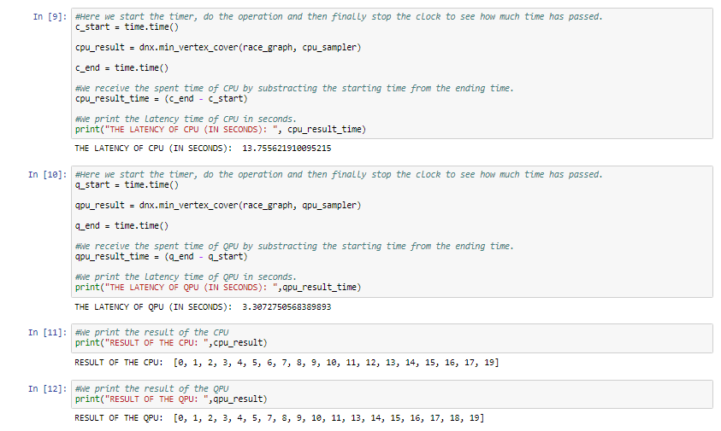

Slide 50
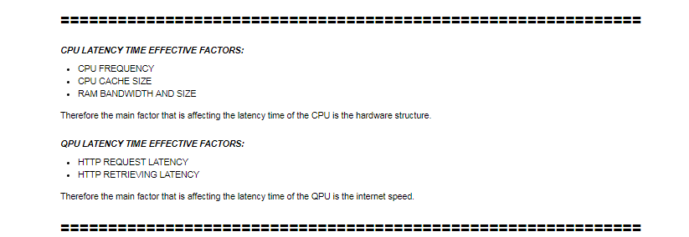

Slide 51
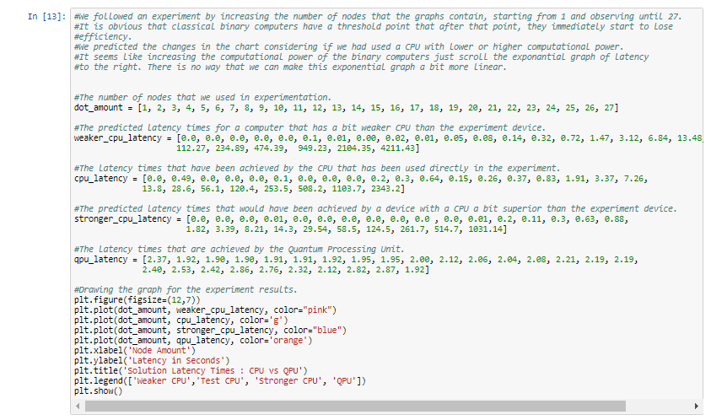

Slide 52
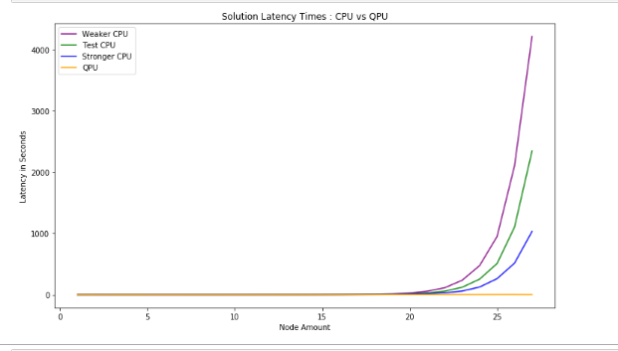

Slide 53
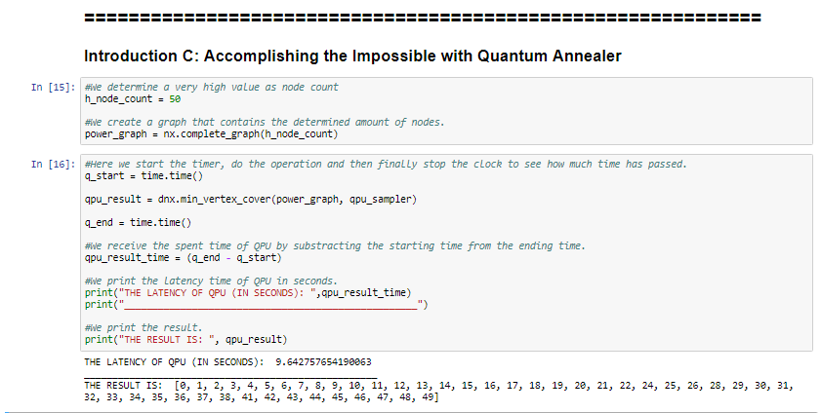

Slide 54
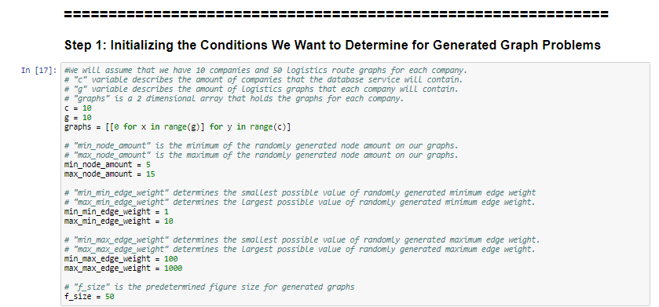

Slide 55
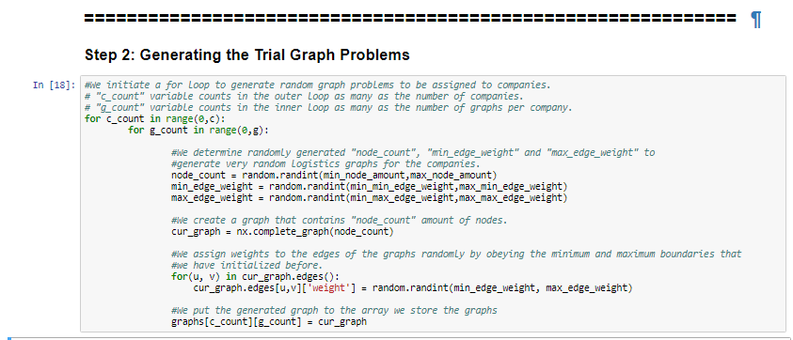

Slide 56
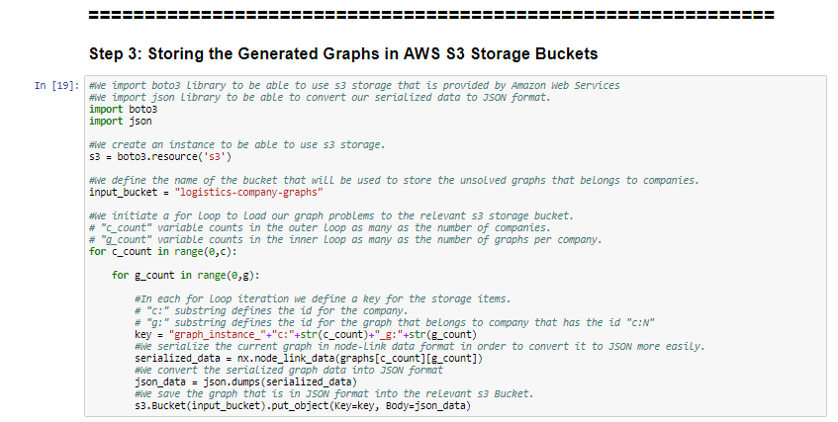

Slide 57
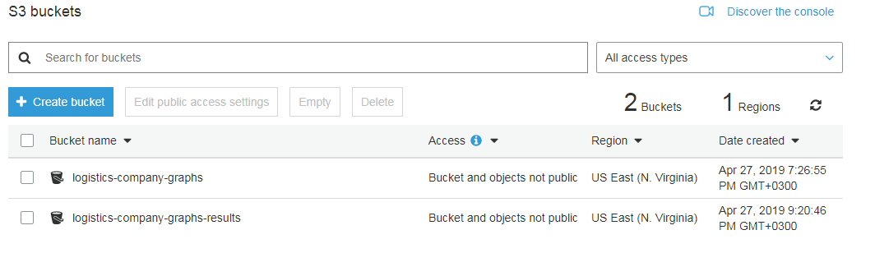

Slide 58
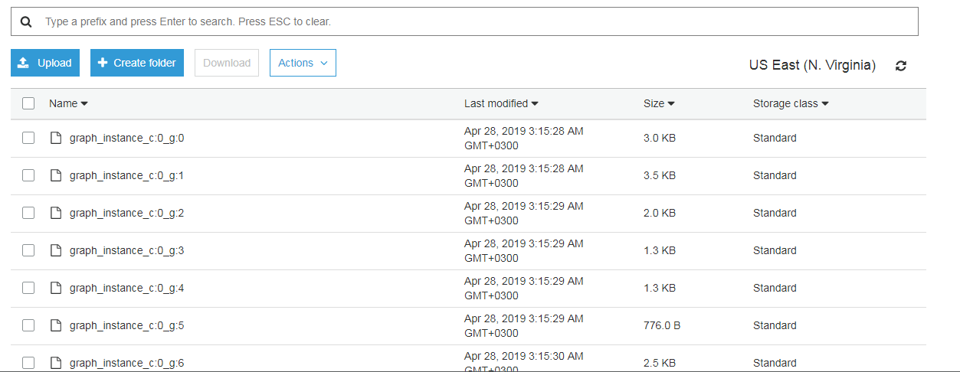

Slide 59
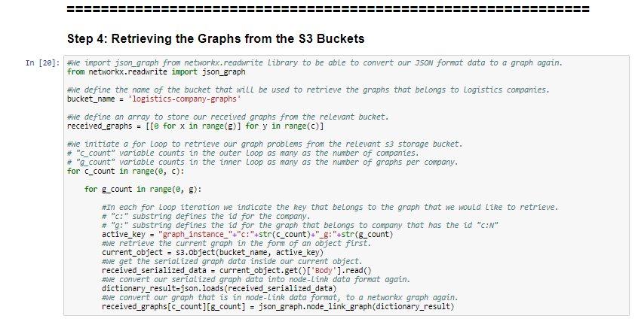

Slide 60
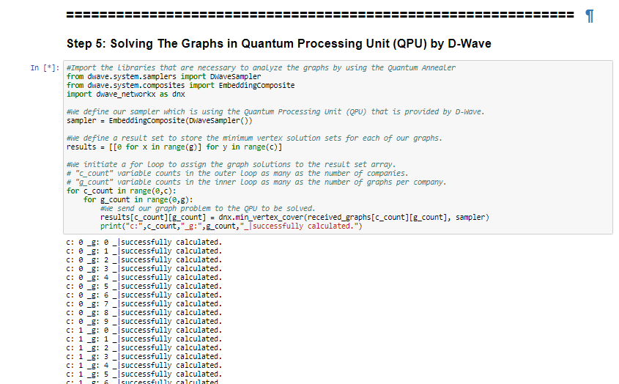

Slide 61
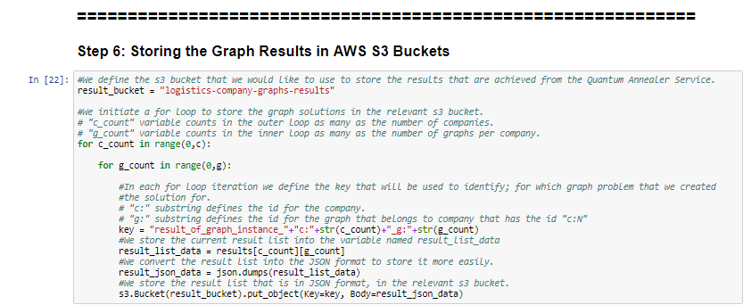

Slide 62


Slide 63


Slide 64


Slide 65
CHALLENGES DURING DEVELOPMENT
The short authorization duration of AWS Tokens.
Relatively high internet propagation delay of Quantum Computer Cloud Service.
Repetitive computer crashes during experiments because of dealing with NP-Hard problems.

Slide 66
solutIons
The dataset that will be sent to the S3 Storage service should be prepared as a whole; instead of sending the data units one by one. This will spare more time for storing/reading data, without renewing the token.
Using a more powerful Wi-Fi/Ethernet network provides higher speeds for using the Quantum Computer Cloud Service.
A computer with 4 GB's of RAM and Intel Core 2 Duo CPU , seemingly crashes during calculating a graph problem with a node count of approximately 25 and more. The experiental values for the CPU should be determined considering the structure and capacity of the hardware.

Slide 67
Thank you.

